Slide 1
UE21CS320A– Project Phase – 1
End Semester Assessment
Project Title : Traffix: Dynamic Scheduling of Traffic
Signals Using Machine Learning
Project ID : 34
Project Guide : Dr. Mannar Mannan
Project Team : Kushaagra Shrivastava PES2UG21CS917
Harshita Khajuria PES2UG21CS194
Rishab A Kumar PES2UG21CS429
Rahul G Pai PES2UG21CS414

Slide 2
Agenda
Introduction and Motivation
Problem Statement
Abstract and Scope
Literature Survey / Existing System
Suggestions from Review – 3
Requirements Specification
Design Approach
Design Constraints, Assumptions & Dependencies
Proposed System / Approach
Architecture
Design Description
Project Report and Progress
References

Slide 3
Introduction and Motivation
The project aims to solve the problem of traffic congestion at junction signals by dynamically scheduling signal timings using machine learning and real time data processing. This enhances traffic efficiency, reduces congestion, and improves overall transportation system performance.
Our system addresses the limitations of traditional fixed-time methods by enabling real-time, lane-specific adjustments based on actual traffic conditions using Google Maps API.

Slide 4
Problem Statement
Currently, on our roads, traffic signals operate in 1 out of 2 ways. Either they are pre assigned a routine where a given signal, or pair of them go green at once, whilst the rest stay red. Or they are operated manually. Additionally, methods to calculate congestion at a signal are all classification based and use simple neural networks
The challenges of this system are particularly evident during peak hours when the congestion levels keep changing frequently. It lacks the smartness to respond quickly and effectively.
Controlling the traffic flow manually is labour-intensive and hard to apply.

Slide 5
Abstract and Scope
The project aims to solve the problem of traffic congestion at signals by dynamically scheduling signals using machine learning and real time data processing.
We are introducing DTSA(Dynamic Traffic Scheduling Algorithm).
Taking an image of the map surrounding the signal, then logically slicing the circle into 3 sectors, based on pixel count.
This logical slicing of map is going to be converted into a 2d array form to be given to an SVM model for scheduling.
LSTM is also going to be added to this model for pre-emption of signals.
We Achieve this using a Client Server Architecture and Machine Learning Models (SVM and LSTM).

Slide 6
Literature Survey
Paper Details | Objective of paper, Techniques/Methods | Advantages | Limitations
Sai Charan Kanigolla, Chaitanya kumar Avala, Likhith Sai kuna, K.L.V. Sai Prakash Sakuru “Smart Traffic Detection and Control using Machine Learning Techniques” 2023 5th International Conference on Energy, Power and Environment: Towards Flexible Green Energy Technologies (ICEPE) | To optimize traffic flow in urban areas by utilizing vehicle detection methods and machine learning to predict and reduce travel delays. Techniques and Methods Used: 1. Vehicle detection through surveillance cameras using object detection techniques. 2. Analysis of historical traffic data and implementation of machine learning algorithms for predicting traffic patterns and optimizing traffic signal timings. | Dynamically allocates signal time for a given lane using a traditional algorithm | Done only for one lane at a time, i.e., only 1 lane is free at a time and not multiple, the way it works in the real world Done only for a up front POV

Slide 7
Literature Survey
Paper Details | Objective of paper, Techniques/Methods | Advantages | Limitations
Nitin N. Sakhare, Subhash B. Tatale, Dr. S. R. Sakhare, Hemant Dusaane , Mamta Puri, Pratika Girme ,Rutuja Sankpal, Padmavati Ghule “Image Processing and IoT Based Dynamic Traffic Management System” International Journal of Scientific Research in Science Engineering and Technology(2020) | Introduce an adaptive traffic management system to address the inefficiency of manual traffic control methods, utilizing Internet of Things (IoT) and image processing technologies. Techniques and Methods Used: 1. Utilization of cameras for constant monitoring of different lanes. 2. Application of image processing to detect and count vehicles in each lane. | Algorithm to greenlight lanes is present Dynamic adjustment of traffic lights for all lanes is present | Only greenlights 1 lane at a time.

Slide 8
Literature Survey
Paper Details | Objective of paper, Techniques/Methods | Advantages | Limitations
P. Fulzele, R. Singh, N. Kaushik and K. Pandey, "A Hybrid Model for Music Genre Classification Using LSTM and SVM," 2018 Eleventh International Conference on Contemporary Computing (IC3), Noida, India, 2018 | The LSTM was trained to find patterns in how the music changes over time. The SVM was trained to make strong genre classifications. To classify a new song, add up the "confidence scores" from both modes and go with the maximum value | The combined system nailed the genre of songs 89% of the time, which was better than either model could do by itself. Possible Speed Boost: While not measured directly, the SVM part probably makes the whole process faster. | They only take a look at a general overview of the song, not focusing on how it changes dynamically. Traditional machine learning can get bogged down with complex music data, either not being accurate enough or slowing to a crawl.

Slide 9
Literature Survey
Paper Details | Objective of paper, Techniques/Methods | Advantages | Limitations
Weisheit, Toni & Hoyer, Robert. (2014). “Prediction of Switching Times of traffic actuated Signal Controls using Support Vector Machines.”Advanced Microsystems for Automotive Applications 2014. | Develop an algorithm for predicting traffic actuated signal controls and establish its mathematical foundations. Techniques and Methods Used: 1. Utilization of Support Vector Machines (SVMs) for predicting traffic light changes. 2. Analysis of structured traffic data to improve prediction accuracy. | Predicting several light changes ahead based on overall traffic volume Predicting just the next change using updated traffic volume Super short-term prediction within the current light cycle based on individual cars being detected | Traffic Isn't Predictable: Some lights follow simple schedules, others change completely based on how busy the roads are. Naturally, predicting the unpredictable lights is harder. Data Delays: It takes time to collect traffic data and make it usable. This delay makes it difficult to 'see' the traffic situation in real-time, which is important for accurate predictions. The accuracy for one of the proposed methods is over 95% which indicates that it is overfitting.

Slide 10
Literature Survey
Paper Details | Objective of paper, Techniques/Methods | Advantages | Limitations
C. -J. Choe, S. Baek, B. Woon and S. -H. Kong, "Deep Q Learning with LSTM for Traffic Light Control," 2018 24th Asia-Pacific Conference on Communications (APCC), Ningbo, China, 2018, pp. 331-336, doi: 10.1109/APCC.2018.8633520. | Investigate the potential benefits of combining LSTM recurrent neural networks and DQN deep-q networks for real-time, dynamic traffic light control (TLC) to improve decision-making and traffic flow efficiency. Utilization of LSTM recurrent neural networks and DQN deep-q networks for analyzing traffic patterns and making dynamic decisions in traffic light control systems. | The AI ​​system combines MLP (Multi-Layer Perceptron) and LSTM using Keras and TensorFlow algorithms. It takes advantage of the DQN algorithm, for learning matching experience replay and objective networks. | Does not provide adequate insight on the models itself. It does not implement analytic+ method into ML models to test how well it integrates with existing models.

Slide 11
Literature Survey
Paper Details | Objective of paper, Techniques/Methods | Advantages | Limitations
Cao J, Fang Z, Qu G, Sun H, Zhang D. “An accurate traffic classification model based on support vector machines”. Int J Network Mgmt. 2017 | Develop methods to streamline data processing and optimize SVM settings for efficient multi-class traffic classification. Techniques and Methods Used: 1. Data preprocessing to mitigate data overload. 2. Implementation of PCA for feature selection and simplification, alongside PSO for automated SVM optimization. | SPP-SVM is 98.6% accurate for simpler classifications, and still over 92% even when things get complex. Reduced the data needed by almost 90% Real-Time Ready: This classifies traffic in under a second. Sample Smart: Works great even with small training sets. | Parameter Sensitivity: The performance of SVMs heavily relies on the choice of the penalty parameter and kernel function parameters. Finding the optimal values can be time-consuming. Difficulty in Handling Large Feature Sets: If many features are extracted from the network traffic data, SVM performance can degrade.

Slide 12
Summary of Literature Survey
Paper 1: Smart Traffic Detection and Control using Machine Learning Techniques
Paper 2: Image Processing and IoT Based Dynamic Traffic Management System
Paper 3: A Hybrid Model for Music Genre Classification Using LSTM and SVM
Paper 4: Prediction of Switching Times of traffic actuated Signal Controls using Support Vector Machines.
Paper 5: Deep Q Learning with LSTM for Traffic Light Control
Paper 6: An Accurate Traffic Classification model based on support vector machines
Overall:
Valuable insights for traffic management improvement.
Need for multi-lane control.

Slide 13
Suggestions from Review - 3
The following assumptions were suggested:
Static/parked vehicles that contribute to traffic data are to be neglected.
Model only works for 1 layer of a junction, i.e, no highways or underpasses.

Slide 14
Requirements Specification
User Interfaces
Web app based for demonstration of the project. Final project won’t have a defined GUI for the users
Software Requirements
MySQL Database / Cloud Bucket Storage
Python 3.10+
PyTorch OR TensorFlow APIs
Cloud Compute Architecture

Slide 15
Requirements Specification
Hardware Requirements
CPU: A processor with capabilities equivalent to or surpassing the Intel Core i5 6th Generation.
RAM: Minimum 8GB RAM to ensure smooth operation and efficient handling of real-time traffic data.
Operating System: Compatibility with Windows 10 or higher versions for optimal performance.
GPU: NVIDIA GeForce GTX 960 or a superior graphics processing unit to support advanced visualizations and simulations.

Slide 16
Requirements Specification
Performance Requirement
Capable of real time data processing
Reliable signal time output
Capability to provide schedule within acceptable times.
Other Requirements
Portable - Should work on Lightweight Thin Hosts
Scalability - Architecture should be able to handle multiple similar requests from different traffic signals
Response Time - Should be capable of real time data processing

Slide 17
Requirements Specification
Safety Requirements
Don’t let 2 lanes that could probably collide go green at the same time
Security Requirements
Should be invulnerable to attacks trying to feed wrong data to models to mess up traffic signal timings
Dataset should be from accurate source

Slide 18
Design Details
Novelty
Traffic signal optimization by leveraging real-time traffic data from Google Maps
Using SVM+LSTM for traffic signal scheduling
Innovativeness
Dynamic adaptation to changing traffic conditions, where signal timings are continuously adjusted based on real-time data analysis
Performance
Capable of real time data processing
Reliable signal time output
Capability to provide schedule within acceptable times.

Slide 19
Design Details
Security
Should be invulnerable to attacks trying to feed wrong data to models to mess up traffic signal timings
Dataset should be from accurate source
Portability
Platform-independent, allowing for deployment across different hardware environments and operating systems

Slide 20
Design Details
Legacy to modernization
Bridge between legacy traffic management systems and modern, data-driven approaches, facilitating the transition to more adaptive and efficient traffic control methods.
Reusability
Reusable components include machine learning models for traffic prediction and optimization, API interfaces for data integration, and modular software architecture for scalability and extensibility.

Slide 21
Design Details
Application compatibility
Compatible with common traffic management applications, including traffic signal controllers, traffic simulation software (e.g., SUMO)
Resource utilization, Etc.,
Optimizes resource utilization through efficient algorithms for real-time data processing, scalable cloud infrastructure for computational tasks, and bandwidth management for data transmission.

Slide 22
Design Constraints, Risks, Assumptions & Dependencies
Constraints:
Regulatory Policies: Adherence to local and national traffic regulations and policies may limit the flexibility of certain features, particularly in areas with strict regulatory control over traffic signal operations.
Hardware Limitations: Signal timing requirements and limitations of existing traffic signal controllers may constrain the system's ability to implement certain adaptive traffic control strategies.
Dependencies on simulation programs may impose constraints on the accuracy and flexibility of traffic modeling.
Depends on data provided by the API call, which may or may not accurately reflect current scenarios.

Slide 23
Design Constraints, Risks, Assumptions & Dependencies
Assumptions:
Parallel Operations: Assumes parallel operations of the existing traffic management systems, and the dynamic traffic scheduling system will complement rather than replace traditional static systems during the initial implementation.
Criticality of Application: Assumes a critical need for real-time traffic management but acknowledges that the dynamic system may not be the sole solution for all scenarios, and traditional methods may still be required in certain situations.
Safety and Security Considerations: Assumes a commitment to safety and security considerations, emphasizing the implementation of secure communication protocols and measures to prevent unauthorized access and malicious activities.
Multi Layered Maps (highways, underpasses) and vehicles that are statically parked which contribute to traffic data are neglected, i.e, out of scope.

Slide 24
Design Constraints, Risks, Assumptions & Dependencies
Risks:
Data Reliability: The risk of compromised traffic management due to inaccuracies or delays in real-time data from various sources.
Acceptance: Resistance or slow adoption by the community may hinder the effectiveness of dynamic traffic scheduling practices.
Security Vulnerabilities: Potential breaches may compromise the confidentiality and integrity of sensitive traffic data, posing risks to system security.

Slide 25
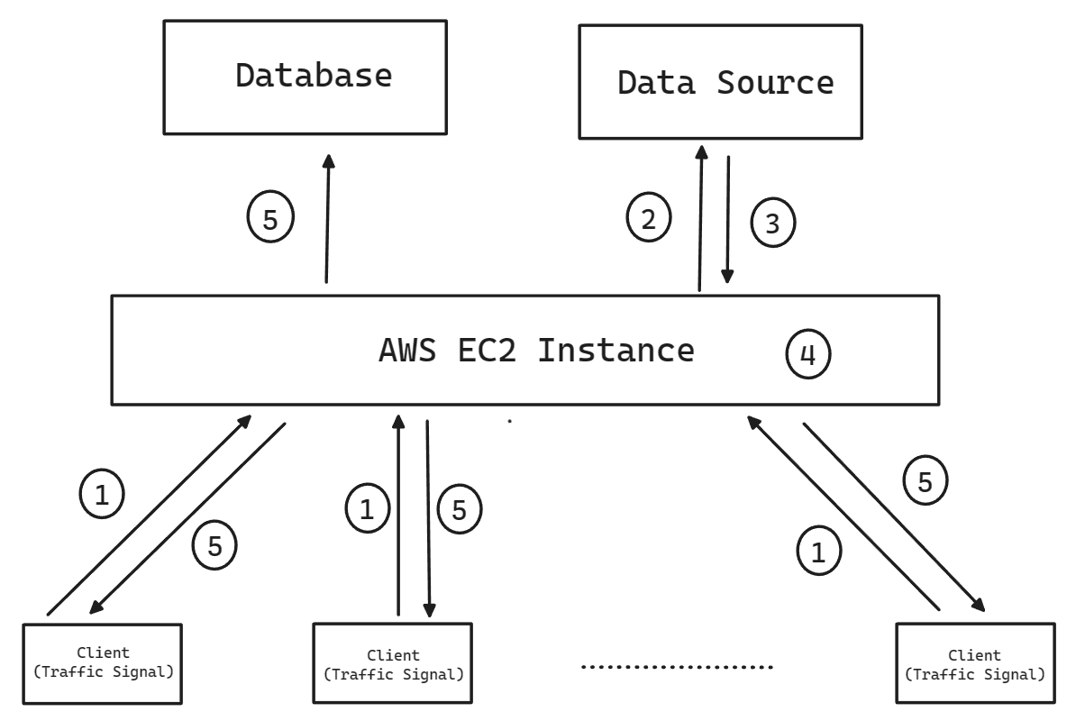
Architecture

Slide 26
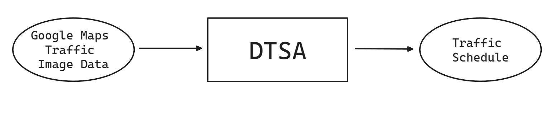
Architecture - Context Diagram

Slide 27
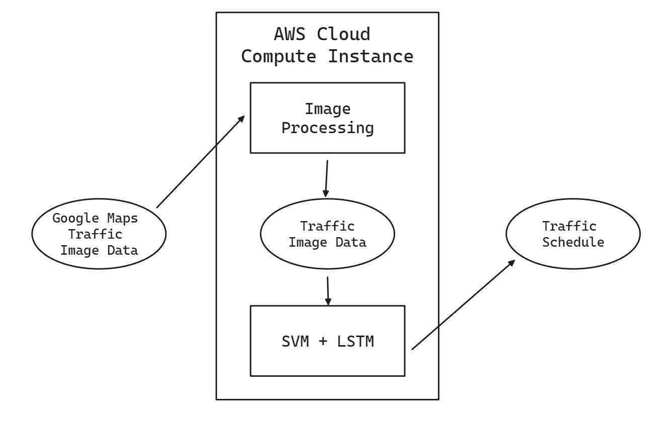
Architecture - Context Diagram

Slide 28
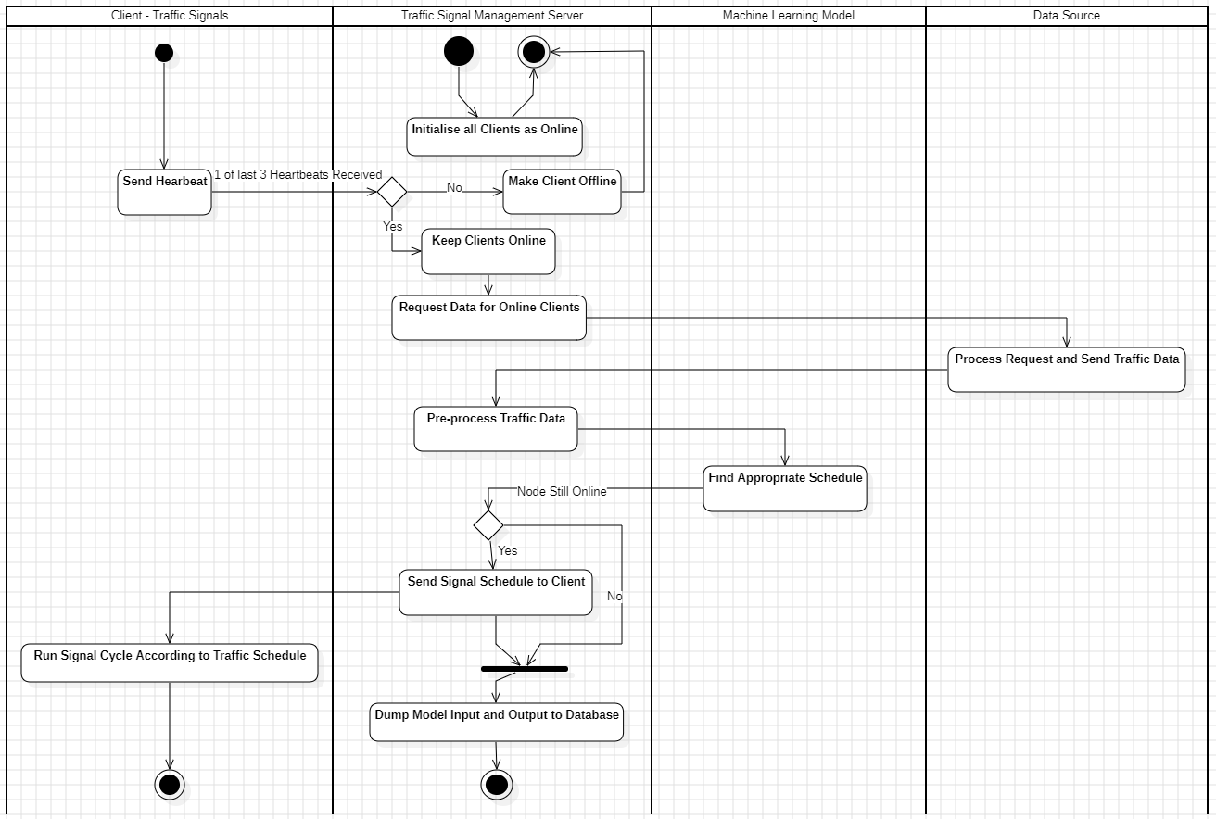
Architecture - Swimlane Diagram

Slide 29
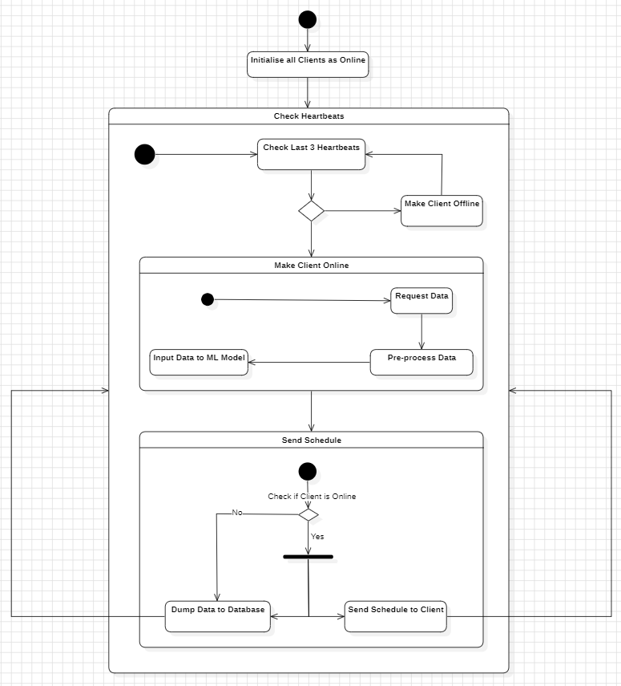
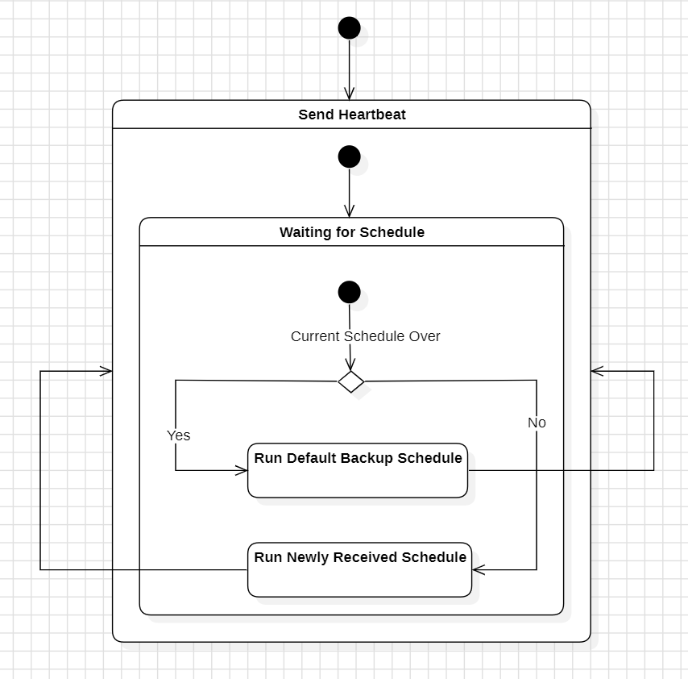
Architecture - State Diagrams
Server Client

Slide 30
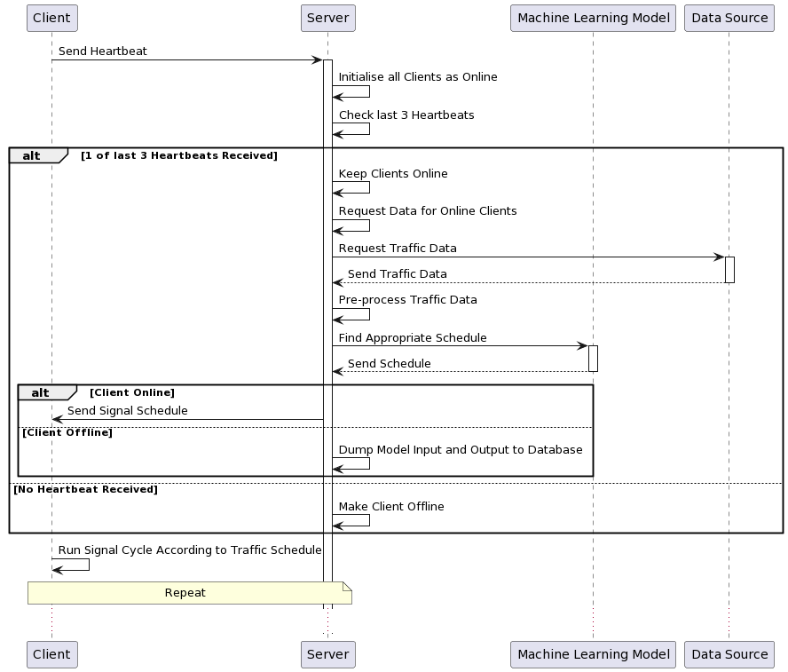
Architecture - Sequence Diagram

Slide 31
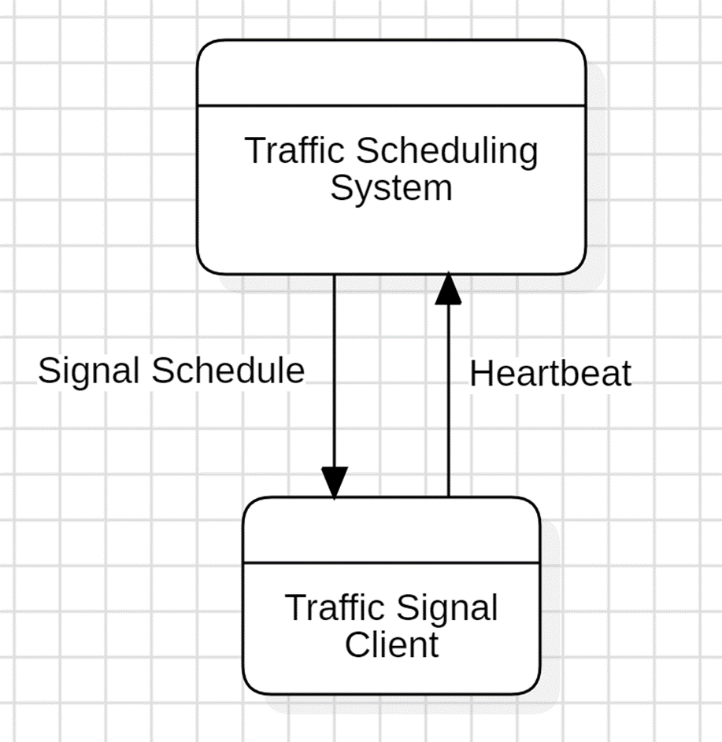
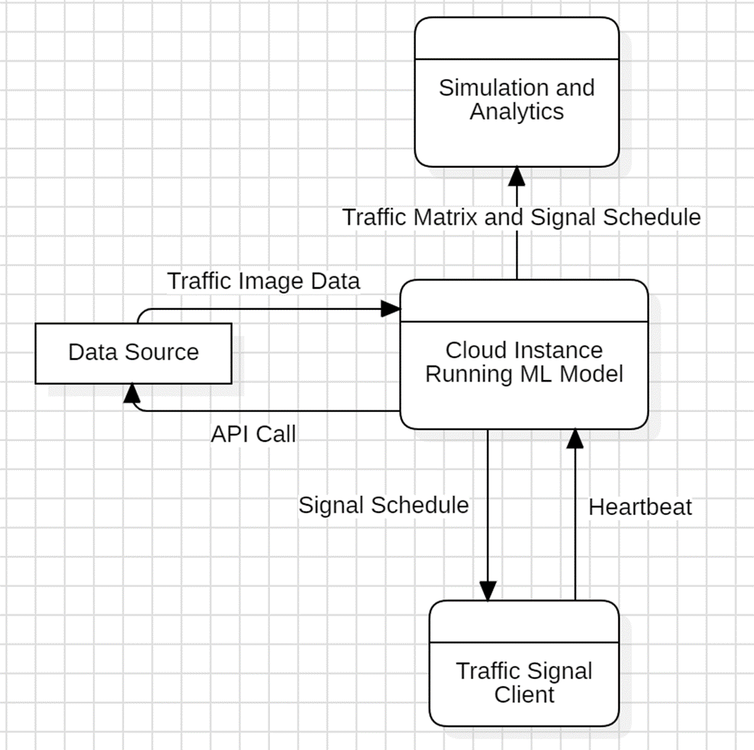
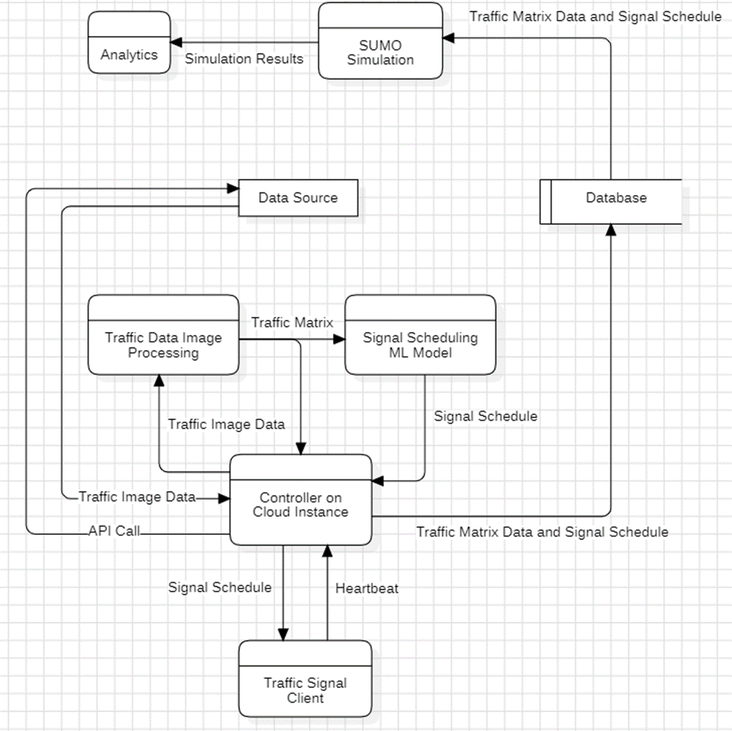
Architecture - Data Flow Diagrams
Level 0 DFD Level 1 DFD Level 2 DFD

Slide 32
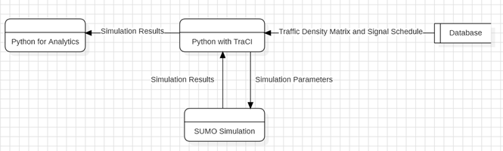
Architecture - Data Flow Diagrams

Slide 33
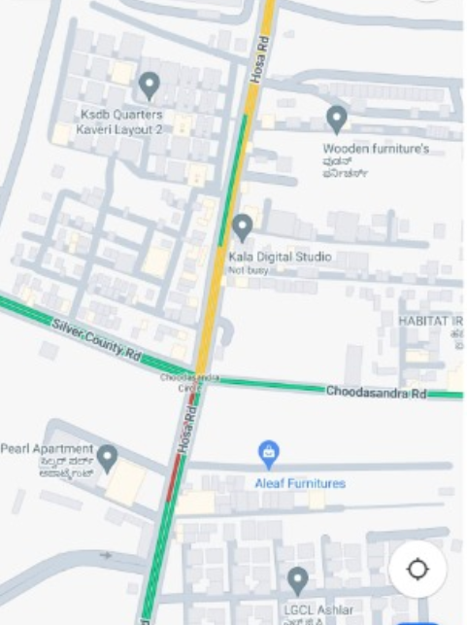
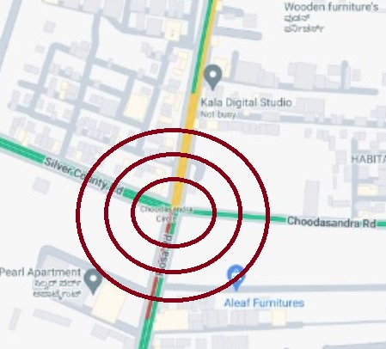

Proposed System / Approach

Slide 34
Proposed System / Approach
Base Model:
We are building a classification model using SVM, the input for this model is taken from Image classification model.
The image classification model uses the images and slices it into 3 layers and gets different colors for the traffic density(VH,H,M,L,VL).
This data is converted into a matrix, which is taken as input for the SVM. The SVM takes the matrix and classifies it into a specific timer value(ranges from 30 to 180).

Slide 35
Proposed System / Approach
Need for change:
The mentioned model never skips a lane during the output generation.
This can cause a increase in traffic congestion, but the model would be better than the existing traffic control system.
We can improve the model and add a pre-emption feature to the model.

Slide 36
Proposed System / Approach
New Approach:
We are modifying the base model(SVM) by adding LSTM to it. This is done to improve the performance with respect to idle green lane conditions and improves overall traffic congestion.
The output from this new model will also be a specific timer value but the range is changed to 0-180. The 0 value helps a lot with the idle green lane condition, but it can also cause misclassification without enough training to the data.

Slide 37
Project Progress
With the amount of work done in our project at the moment, we have completed around 20% of the project.
We Conducted extensive analysis to determine the technologies and methodologies that will be utilized in various phases of our project.
Progress has been made in acquiring a source for data. Namely, the google maps API.
Our team has successfully completed the preliminary requirements specification (PRS) and high-level design (HLD), which will play an important role in the overall project process.
The architecture of the project has also been finalized.
We have found supporting evidence through research for the employment of SVM model, although it comes with certain limitations.
To overcome some of these limitations, we aim to integrate an LSTM model in the project.
We have finalized on the use of SUMO for simulation. This will be employed in the testing phase and will be used to simulate traffic

Slide 38
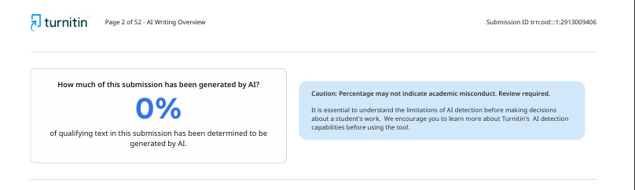
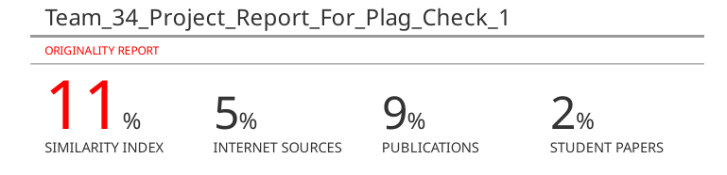
Project Progress
Total Plagiarism
= 0% AI Plag + 11% Similarity
= 11%
Complies with the <=15% limit provided by the university.

Slide 39
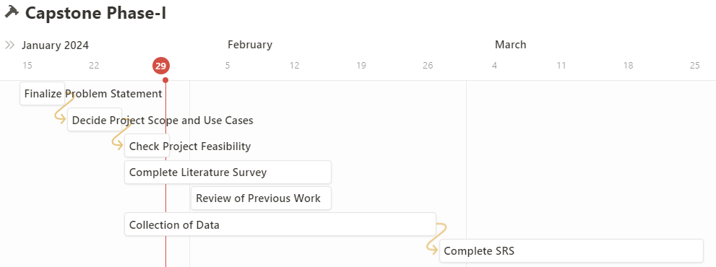
Capstone Phase-I Project Timeline
Provide
The timelines for execution of the project through Gantt chart.
The plan in terms of efforts by individuals in the team.
Mention the tasks involved in different stages.

Slide 40
Capstone Phase-II Project Timeline
With the completion of the documentation, design phases, and basic collection of the dataset for the application, we have successfully completed phase 1. In phase 2, our focus will be on setting up the architecture, building the model, implementing, testing and refining the model.
This can be done in steps as follows:
Acquire the dataset after finalizing the 4 lane junction that will be considered for this project.
Complete the image processing model to refine this dataset and get the matrices for the next part.
Complete the prototype model, this involves refining the SVM part of our model and finalizing the classes.
Implementing the DTSA model and refining the LSTM for feature extraction and getting better classes for SVM.
Simulate using SUMO and test performance with the cloud architecture in place.

Slide 41
Conclusion
The Base model will be implemented using SVM.
The addition of LSTM in order to enable pre-emption will be employed.
With the aid of these models, we aim to reduce congestion across various traffic signals, integrating various technologies, and in a manner that is relatively lightweight.

Slide 42
References
[1] Weisheit, T., Hoyer, R. (2014). Prediction of Switching Times of Traffic Actuated Signal Controls Using Support Vector Machines. In: Fischer-Wolfarth, J., Meyer, G. (eds) Advanced Microsystems for Automotive Applications 2014. Lecture Notes in Mobility. Springer, Cham.doi: 978-3-319-08087-1_12
[2] C. -J. Choe, S. Baek, B. Woon and S. -H. Kong, "Deep Q Learning with LSTM for Traffic Light Control," 2018 24th Asia-Pacific Conference on Communications (APCC), Ningbo, China, 2018, pp. 331-336, doi: 10.1109/APCC.2018.8633520.
[3] S. C. Kanigolla, C. k. Avala, L. S. Kuna and K. L. V. S. P. Sakuru, "Smart Traffic Detection and Control using Machine Learning Techniques," 2023 5th International Conference on Energy, Power and Environment: Towards Flexible Green Energy Technologies (ICEPE), Shillong, India, 2023, pp. 1-4, doi: 10.1109/ICEPE57949.2023.10201549.
[4]P. Fulzele, R. Singh, N. Kaushik and K. Pandey, "A Hybrid Model for Music Genre Classification Using LSTM and SVM," 2018 Eleventh International Conference on Contemporary Computing (IC3), Noida, India, 2018, pp. 1-3, doi: 10.1109/IC3.2018.8530557.
[5]Cao J, Fang Z, Qu G, Sun H, Zhang D. An accurate traffic classification model based on support vector machines. Int J Network Mgmt. 2017;
[6] Sakhare, Nitin & Tatale, Subhash & Sakhare, Sachin & Dusaane, Hemant & Puri, Mamta & Girme, Pratika & Sankpal, Rutuja & Ghule, Padmavati. (2020). Image Processing and IoT Based Dynamic Traffic Management System. International Journal of Scientific Research in Science, Engineering and Technology. 180-188. 10.32628/IJSRSET207230.

Slide 43
Thank You

